Slide 1

DVWA Vulnerabilities
Insecure CAPTCHA: low, medium, high
Keilin Hopkins-Bey, Collin Saxon, Clarissa Martinez

Slide 2

GOAL
Bypass Insecure CAPTCHA in DVWA using Burpsuite
There is a poor CAPTCHA system found within DVWA, so our goal was to change the current user’s password in an automated manner.

Slide 3
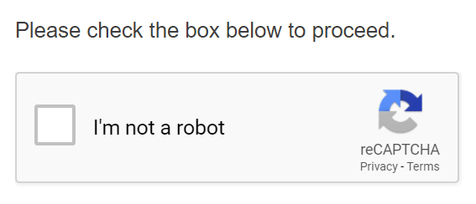
What is CAPTCHA?
Security feature used to verify if the user is a real person or bot
It is possible to bypass CAPTCHA by replaying a specific step in the verification process.
We can trick the system into thinking we have already passed through verification.

Slide 4
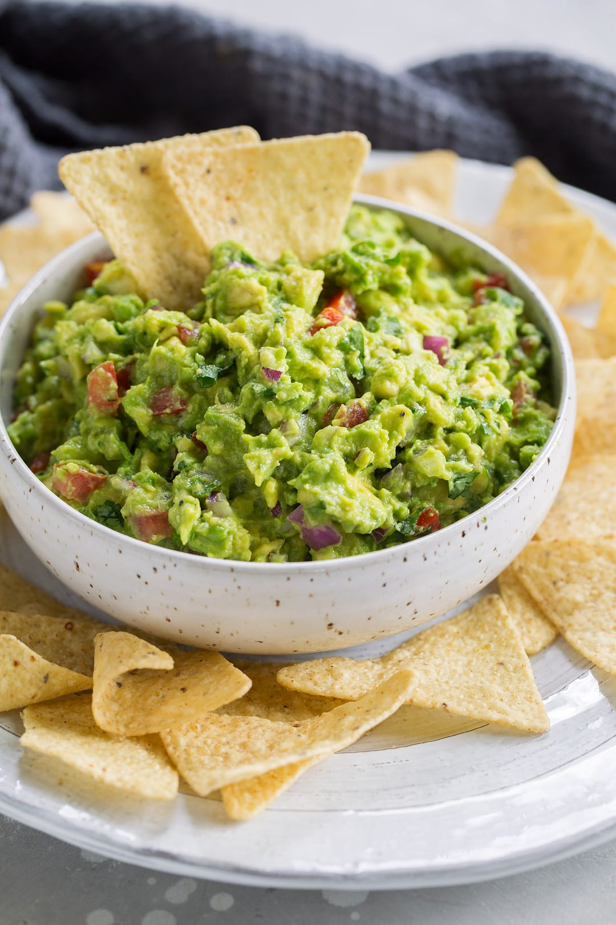
Devices and Technologies
Virtual Machine (Apache Guacamole)
Burp Suite
Docker (DVWA) Damn Vulnerable Web Application

Slide 5
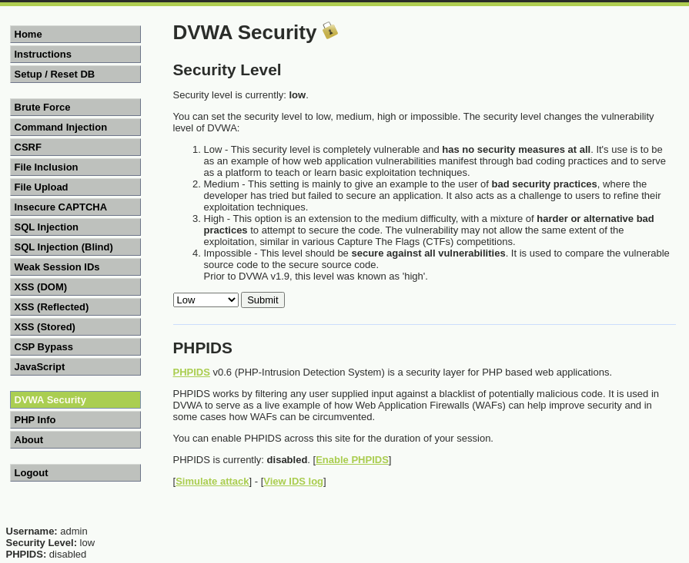
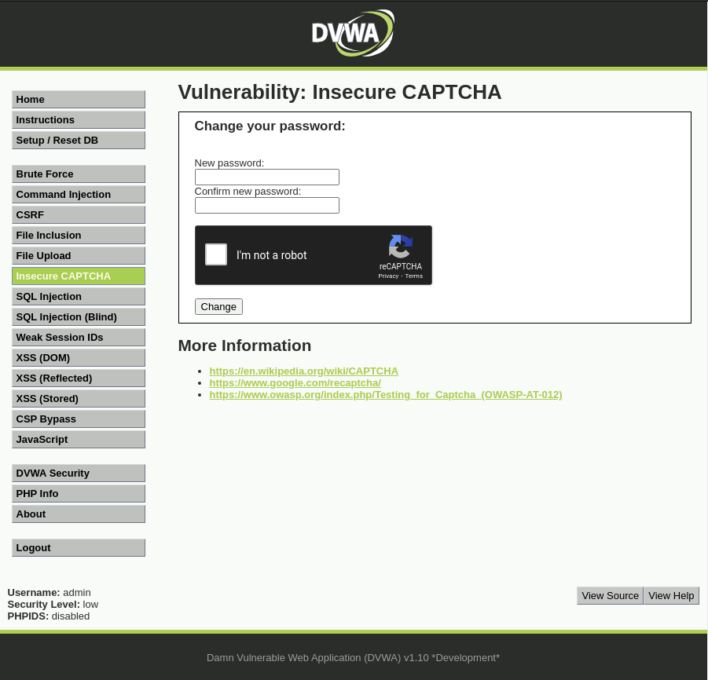

Slide 6
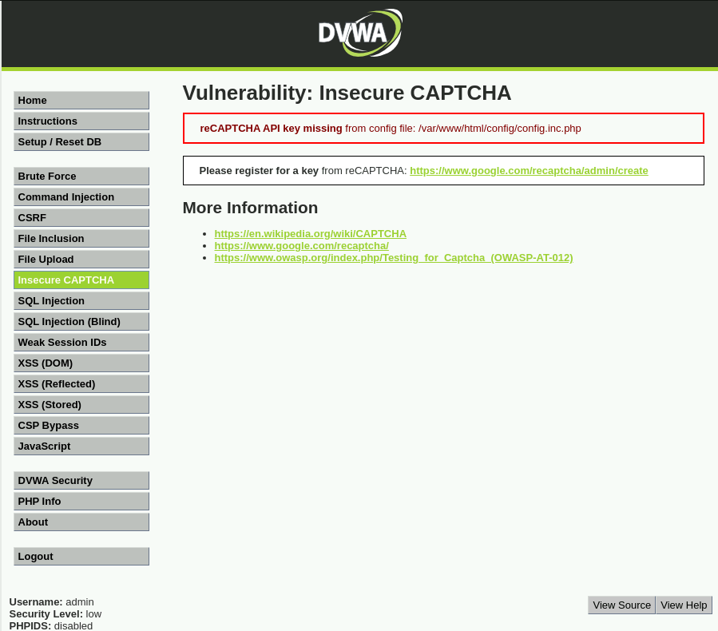
Setup

Slide 7
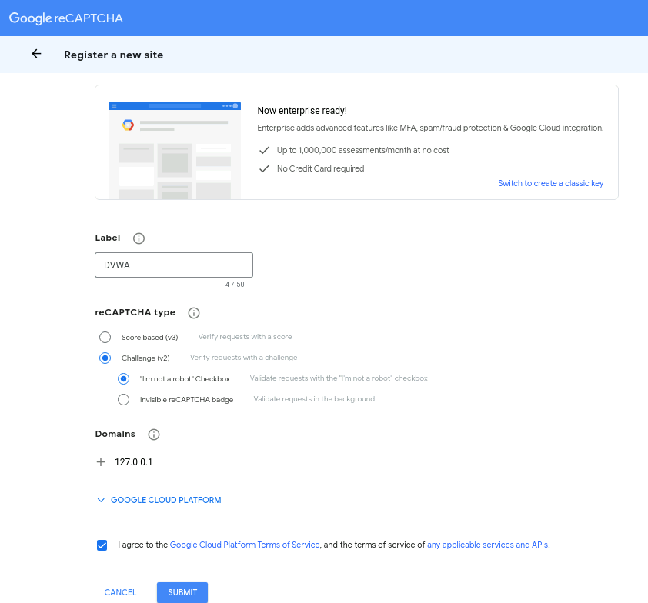
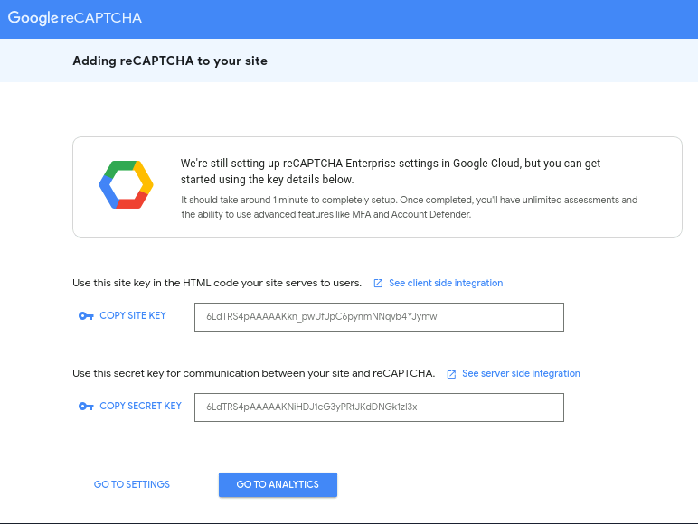

Slide 8
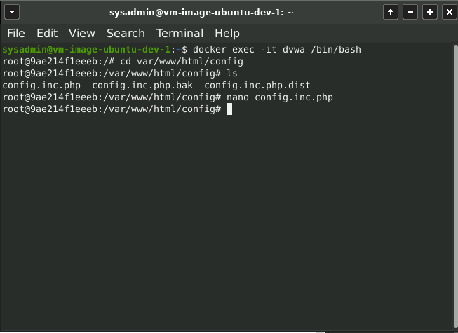
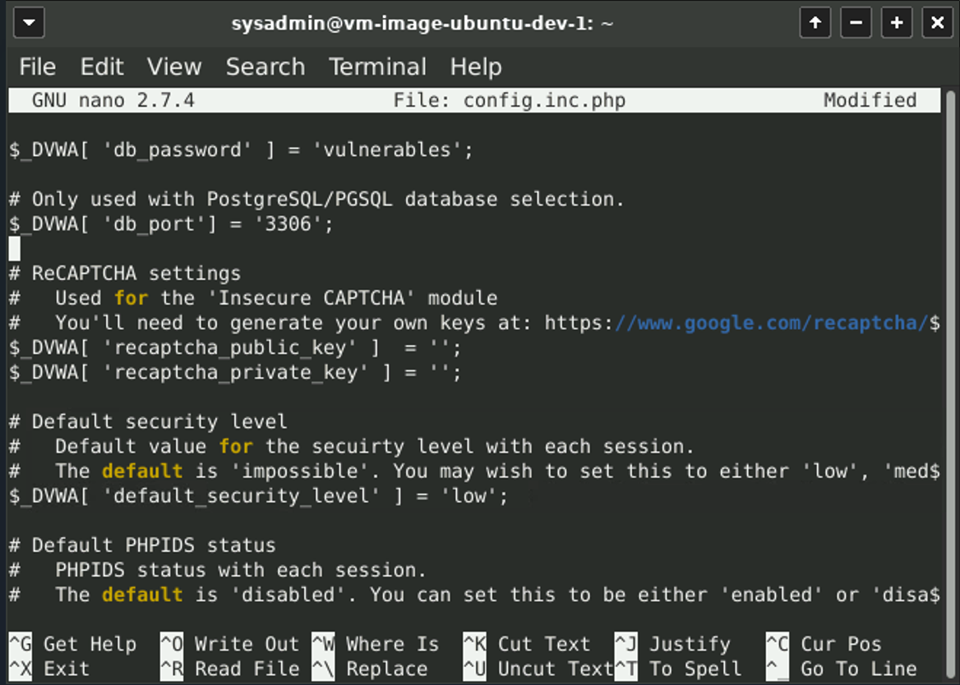
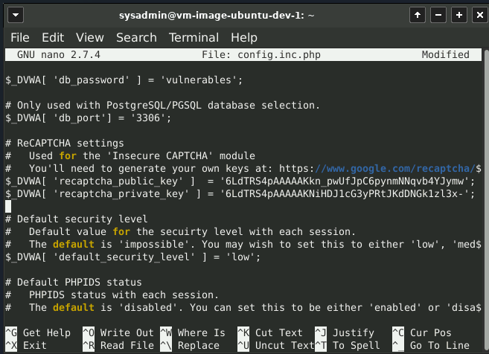

Slide 9
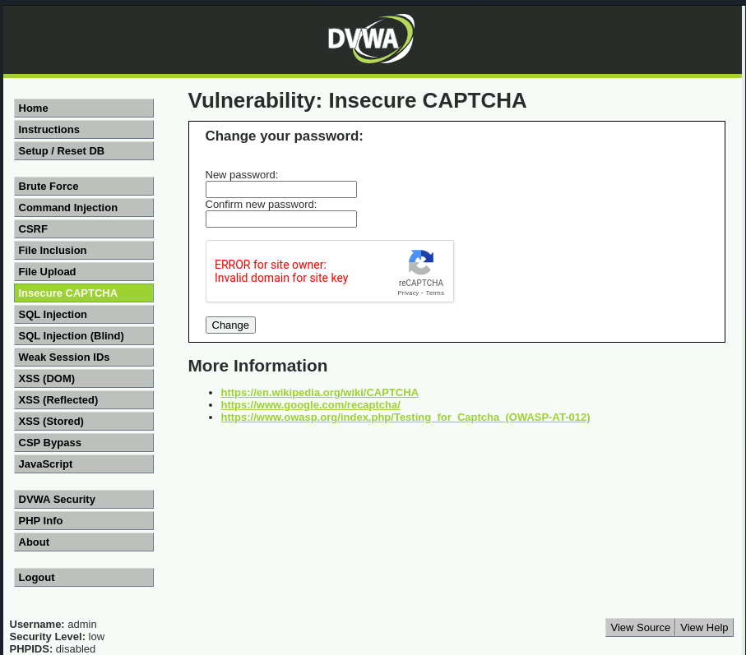

Slide 10
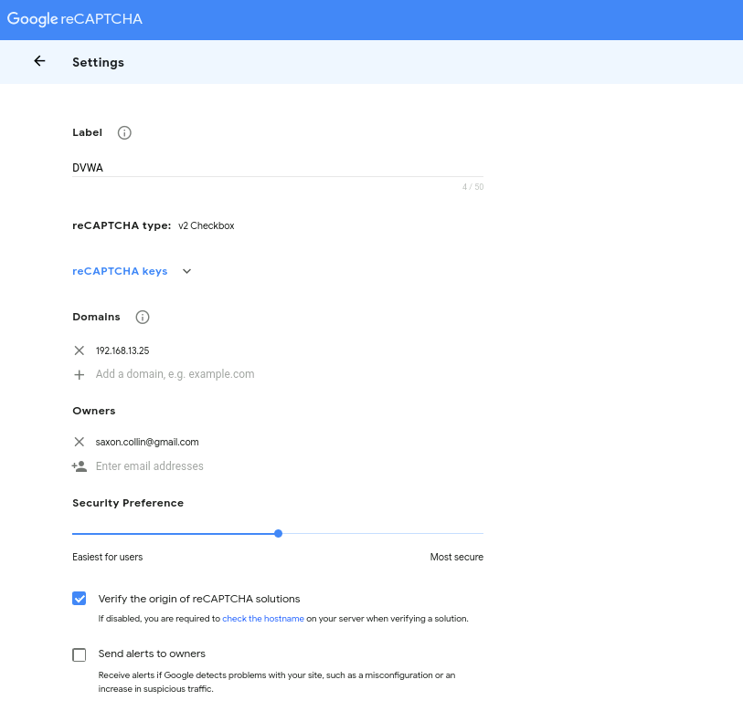
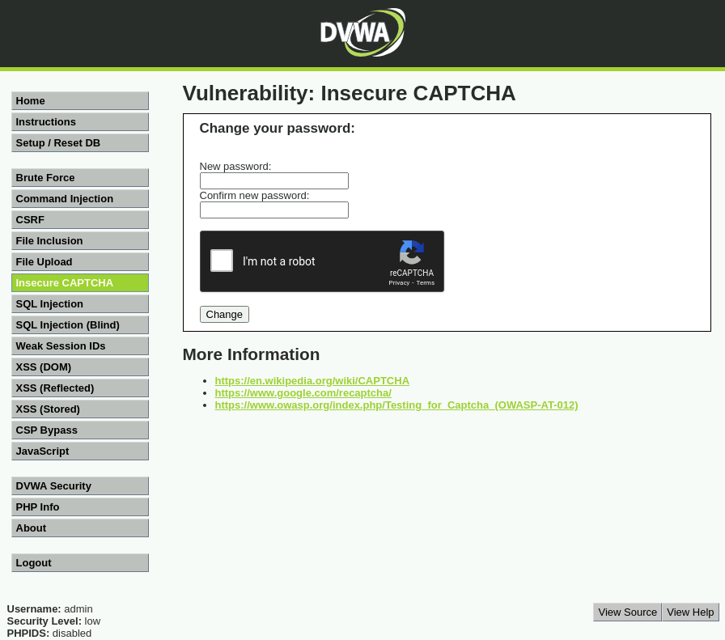

Slide 11

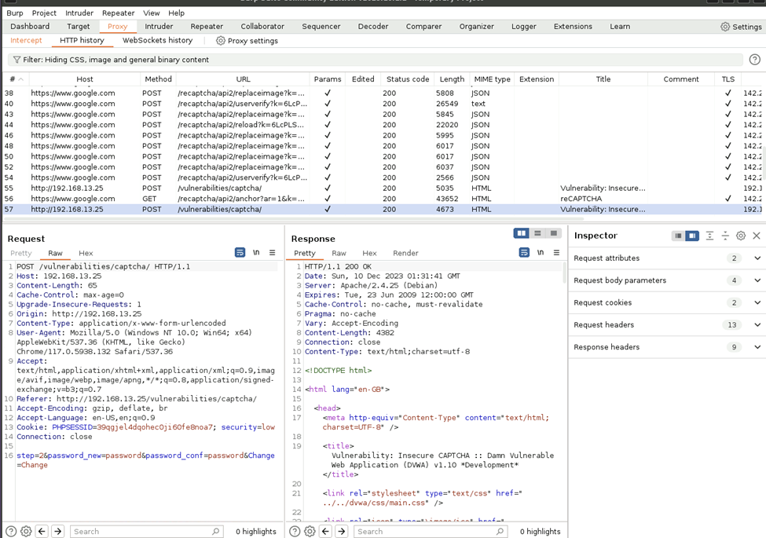
Low Level Security
Captcha can be easily bypassed using Burp Suite Repeater
Users can pass through screen 1, complete the CAPTCHA and move on to next screen where password is updated.
If we submit the password directly to the change page, the user can bypass the CAPTCHA system.

Slide 12
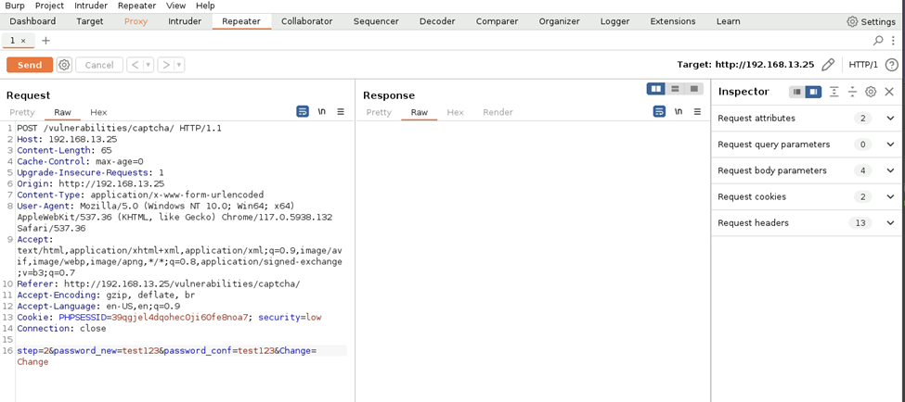
How to Bypass CAPTCHA- Low Level Security
Using Burpsuite we can obtain the POST method from URL /vulnerabilities/captcha/
We then send it to the repeater
Change user’s password and hit send
Password changes or you can open within the browser.

Slide 13
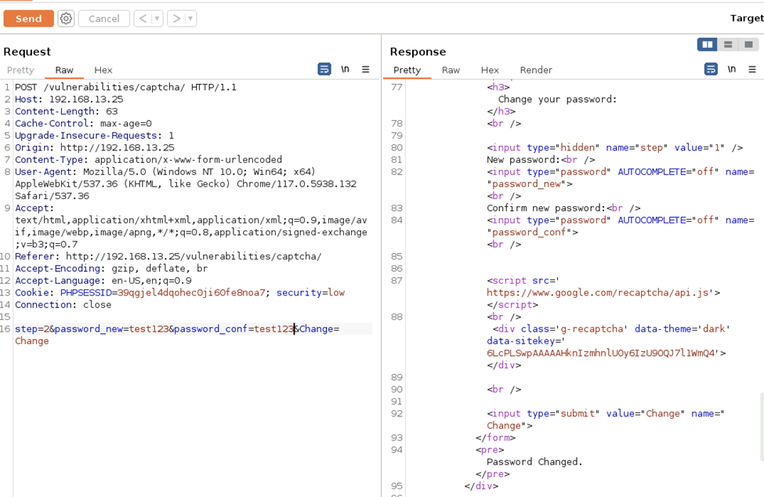
Low Level Security

Slide 14
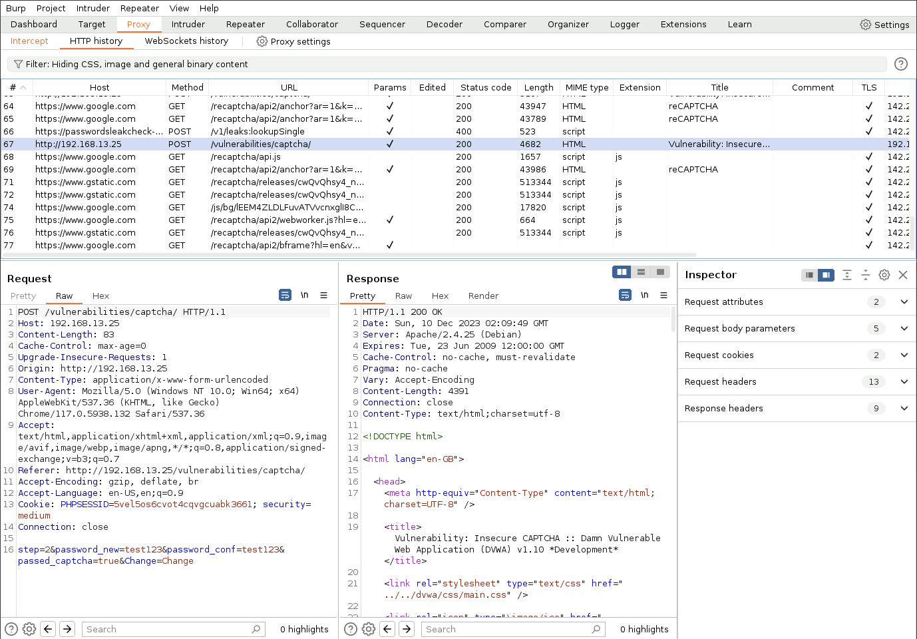
Medium Level Security
We can do the same process through burp suite. The only difference is“Passed_captcha”
Send this to the Repeater and Change password

Slide 15
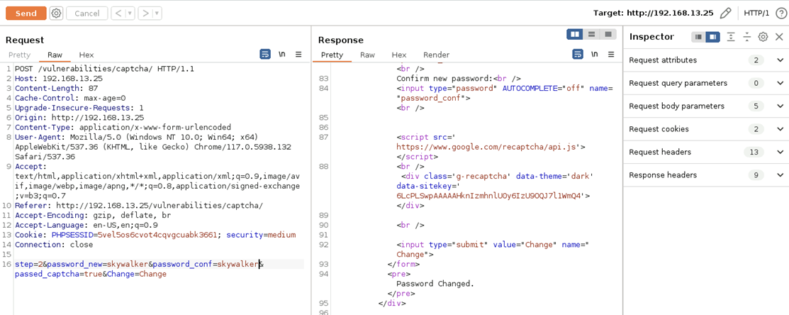

Slide 16
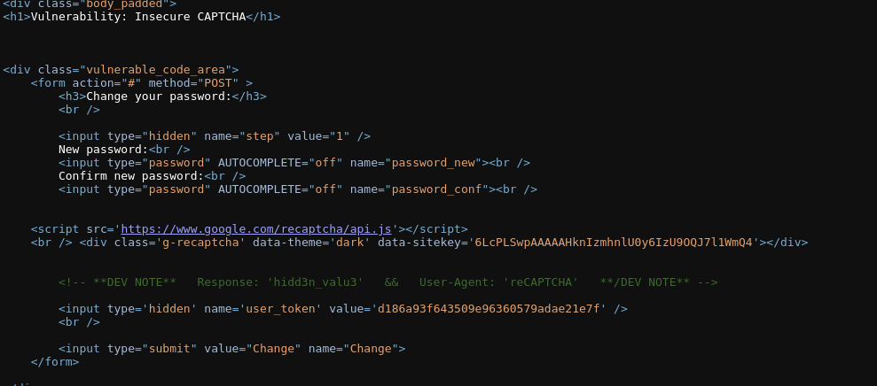
High Level (Insecure CAPTCHA)
Go to View page source
Scroll down and you can see *DEV NOTE* for Response and User Agent
We can use this to manipulate the text in the repeater to bypass CAPTCHA!

Slide 17
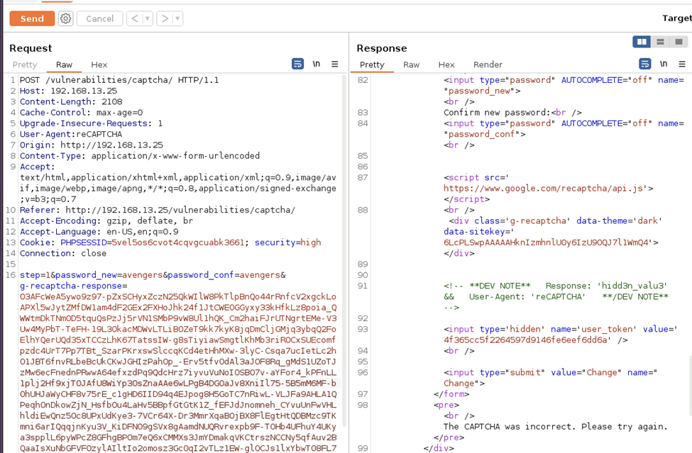
High Level (Insecure CAPTCHA) - Error

Slide 18
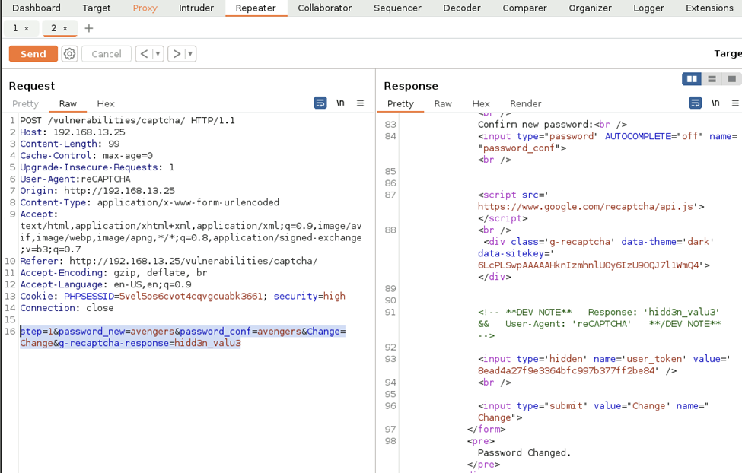
High Level (Insecure CAPTCHA)-Success

Slide 19
Mitigation
Implement rate Limiting
CAPTCHA validation
Strong Algorithm
Limits the number of CAPTCHA requests coming from a single IP address within a certain time period.
Prevents Brute Force
Ensure that validation is performed on server side than on client side.
-prevents bypassing the captcha by manipulating the client-side code (high)
Choosing a strong CAPTCHA algorithm that will be hard to bypass.

Slide 20
Summary
To accomplish our goal of bypassing captcha in an automated manner we used Apache Guacamole as the virtual machine. Using this we accessed the terminal to get into the DVWA container running in the docker web-vulns directory. We also used it to run the Burpsuite program where we could do the automated task of bypassing the CAPTCHA. We used PortSwigger to access the Domain 192. 168.13.35 and send the POST and GET method requests to the repeater through the proxy and successfully change the user’s password.

